Slide 1


Slide 2
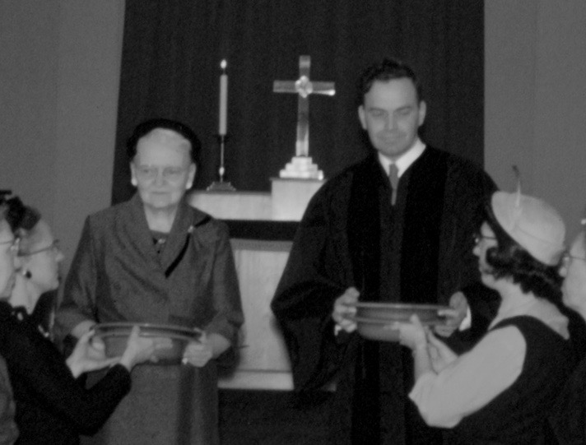

Slide 3


Slide 4
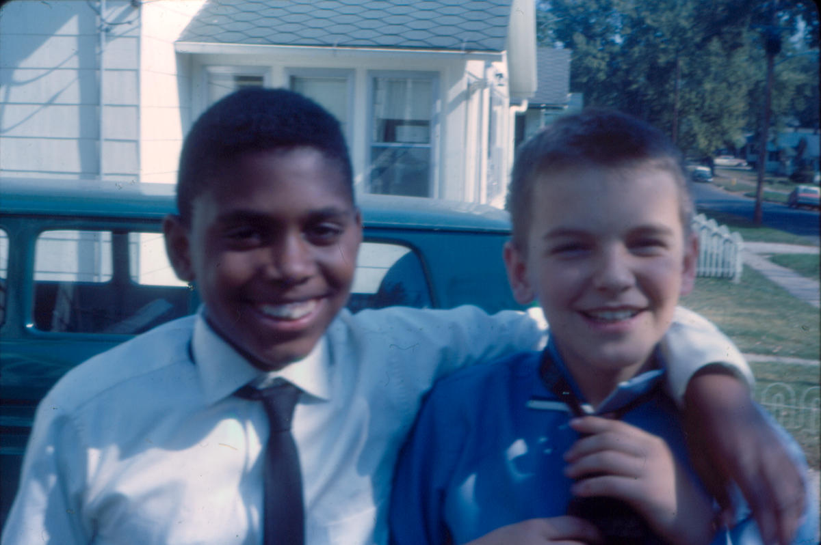

Slide 5



Slide 6
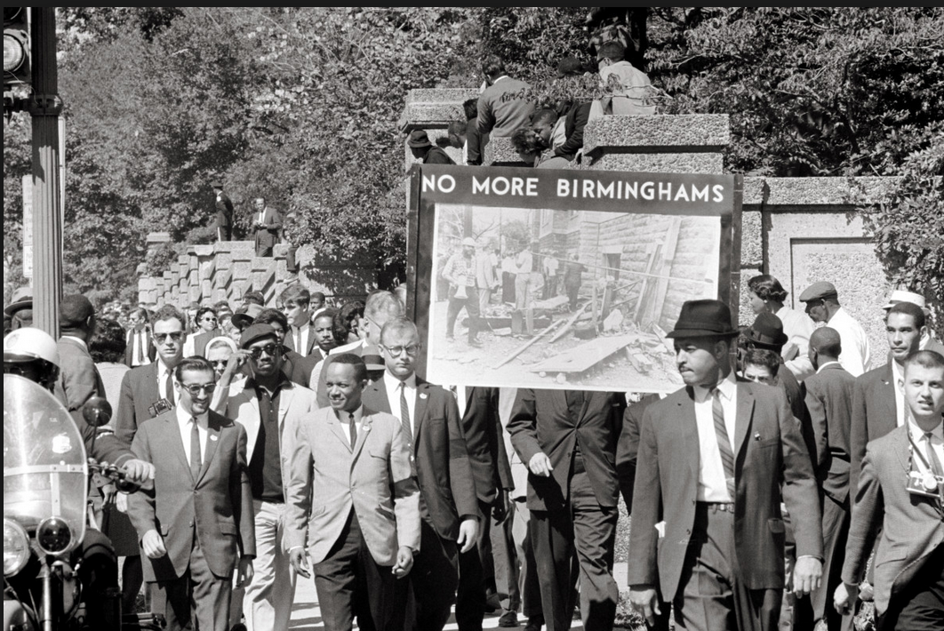
Library of Congress

Slide 7
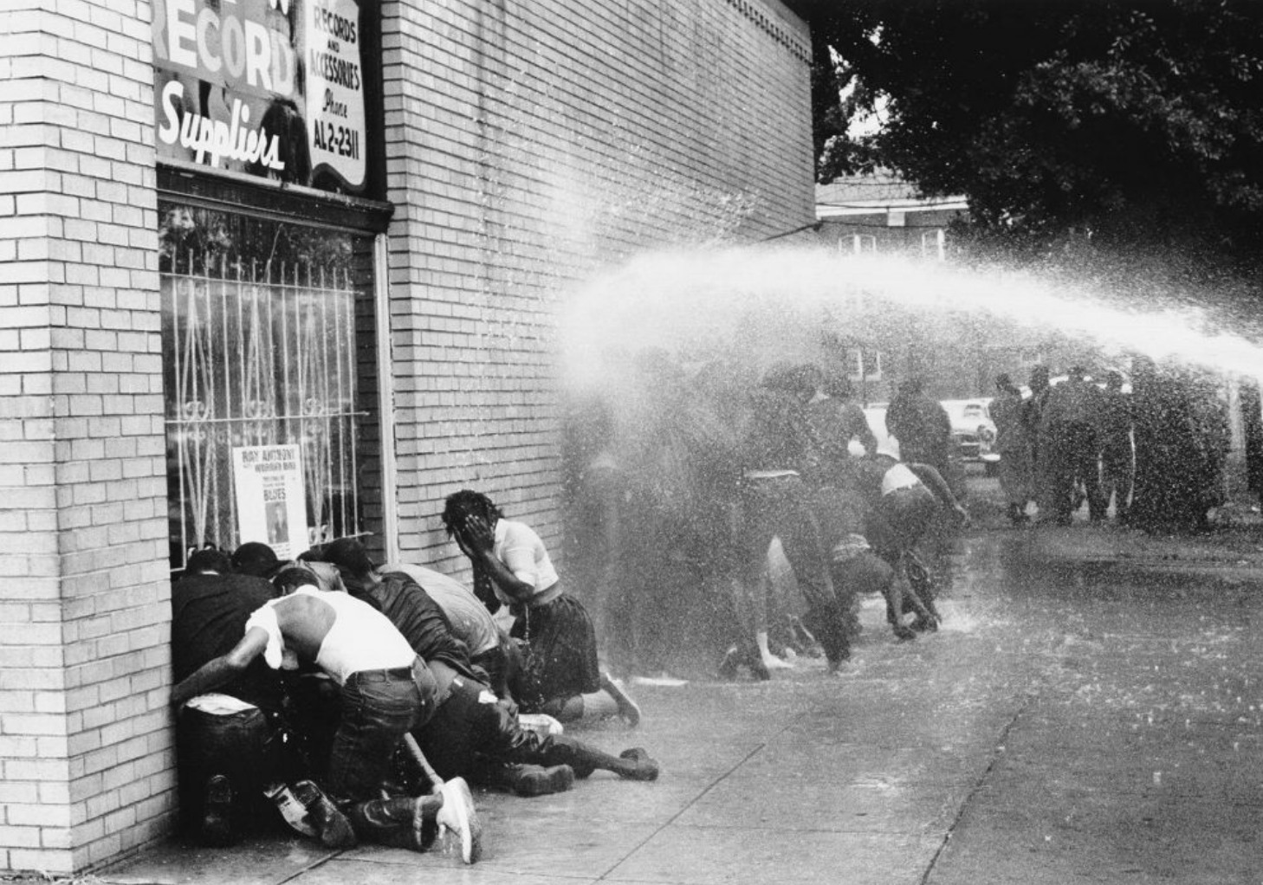
Charles Moore

Slide 8


Slide 9
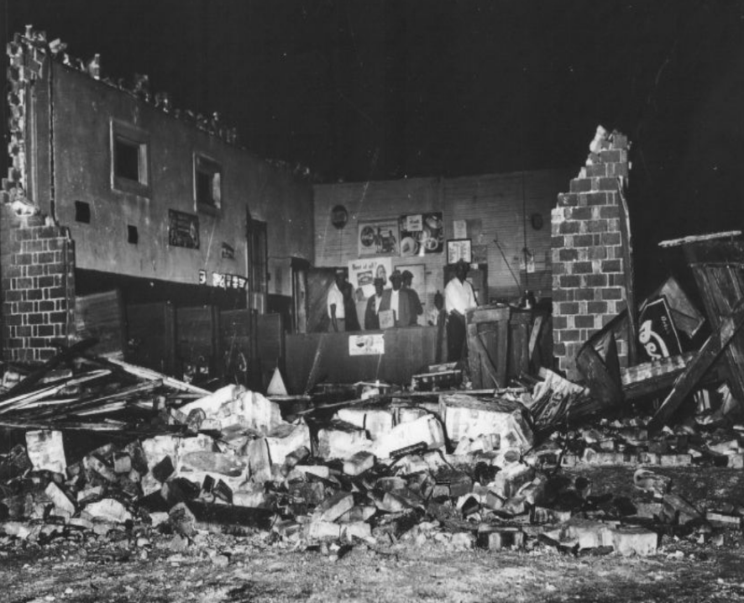

Slide 10
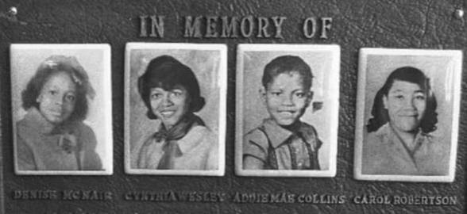

Slide 11
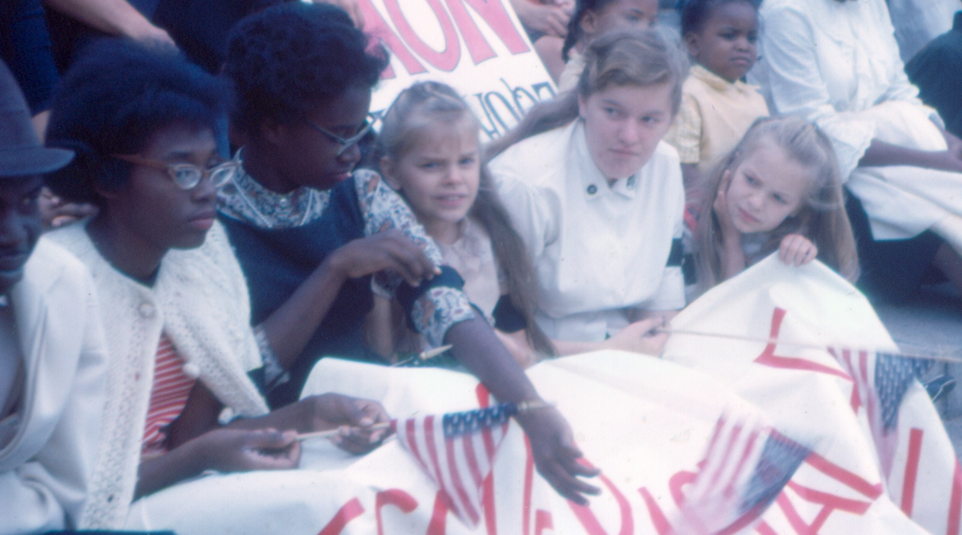

Slide 12
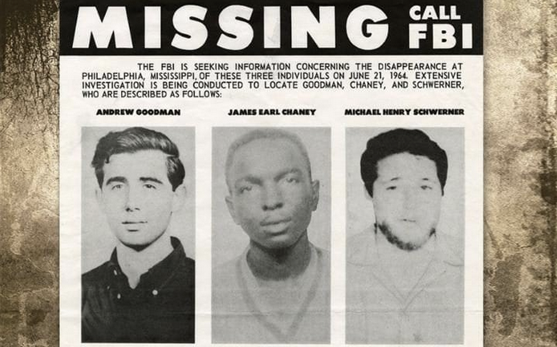

Slide 13
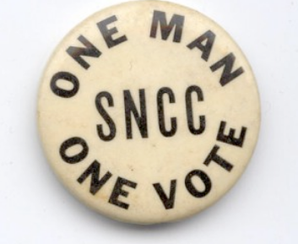
Burnside v Byars

Slide 14

Larry Burrows/LIFE

Slide 15
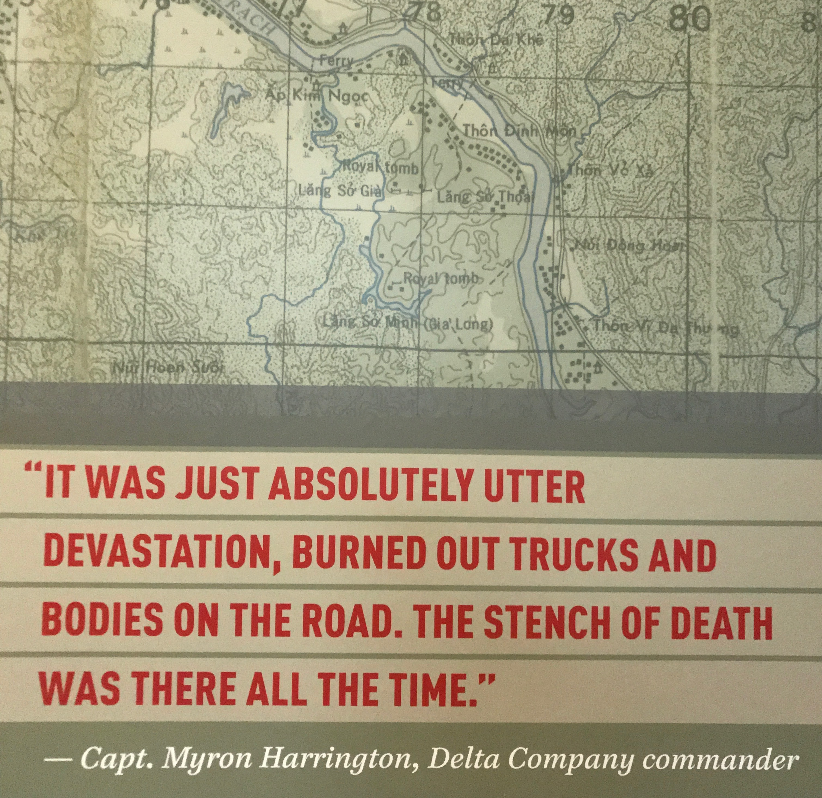

Slide 16
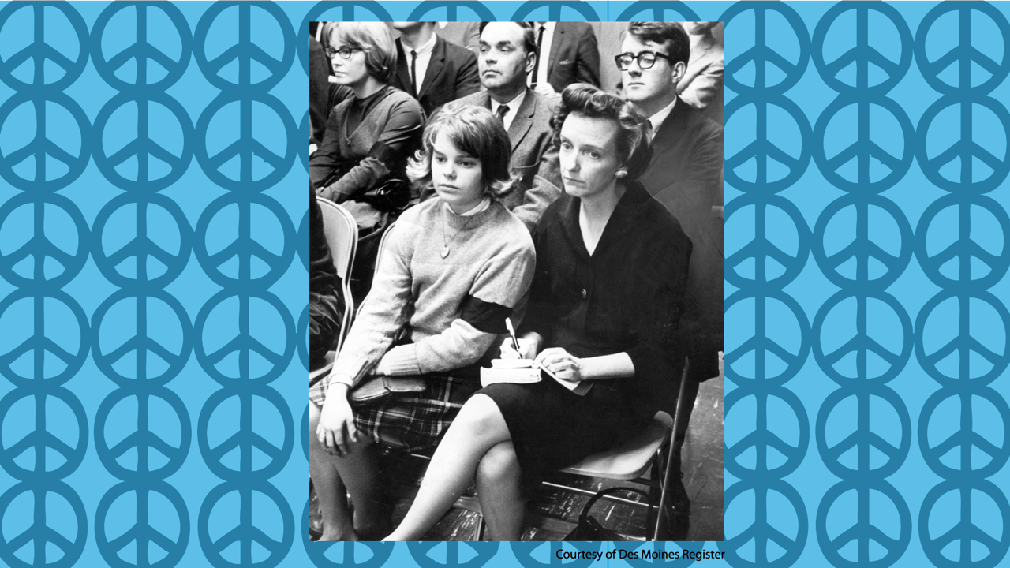

Slide 17


Slide 18
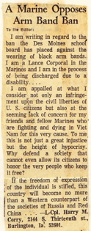
Des Moines Register, December 27, 1965
“I am appalled at...the infringement upon the civil liberties of U.S. Citizens....To me, this is not only a great injustice but the height of hypocrisy.
If...freedom of expression...is stifled, this country will become no more than a Western counterpart of...Russia and Red China.”
L-Cpl. Harry M. Corry,
Burlington, Iowa

Slide 19
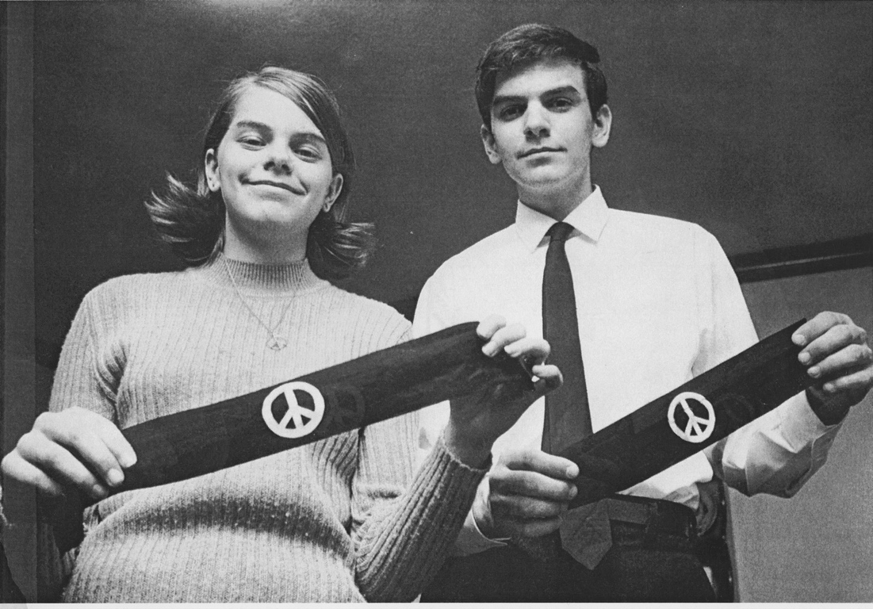

Slide 20
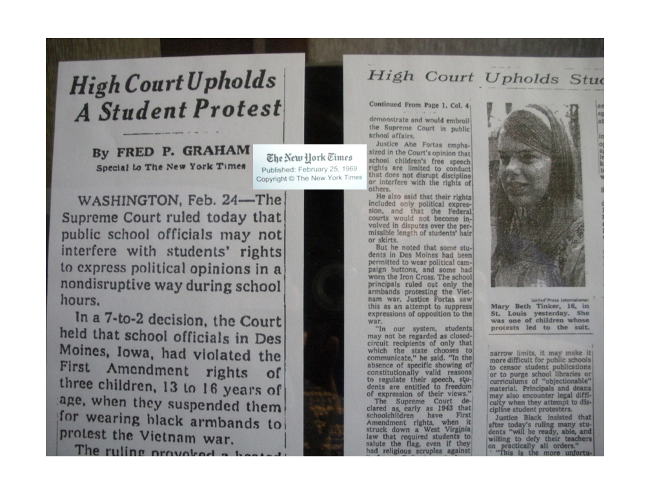

Slide 21


